Slide 1




On Skyline Groups
Chengkai Li
Naeemul Hassan
Gautam Das
University of Texas at Arlington
Nan Zhang
Sundaresan Rajasekaran
George Washington University

Slide 2
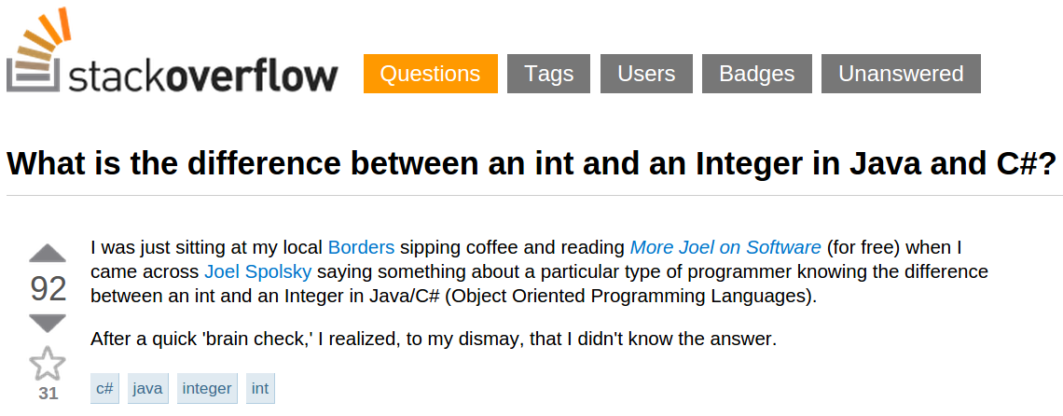
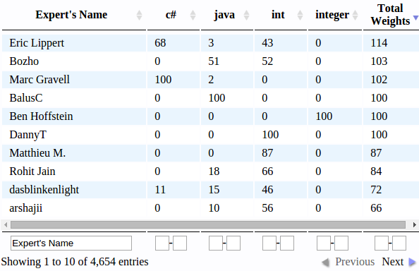
Motivation
Question-Answer Platforms
Question
Skills
Goal: Find a group of experts who can answer this question
1

Slide 3
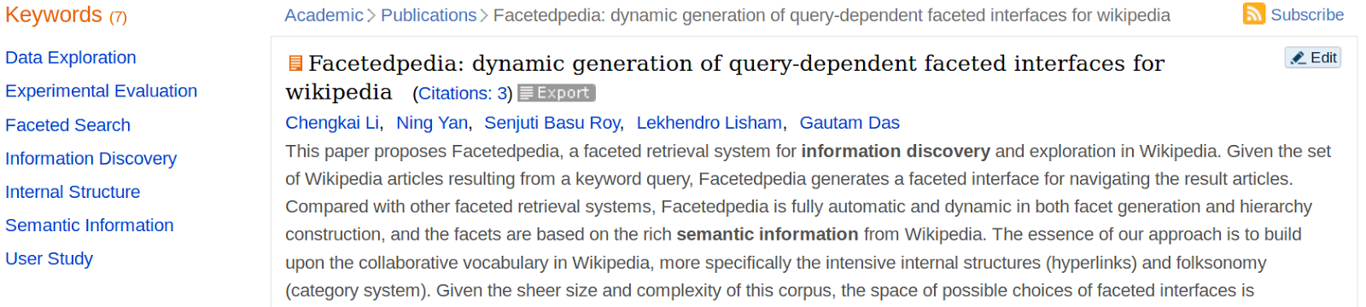
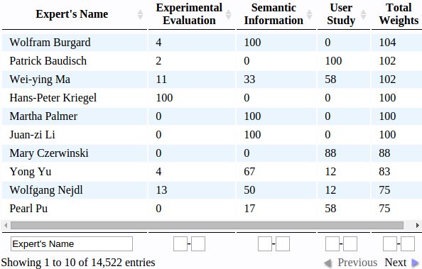
Motivation
Journal/Paper Review
Task
Skills
Goal: Find a group of experts who can review this paper
2

Slide 4
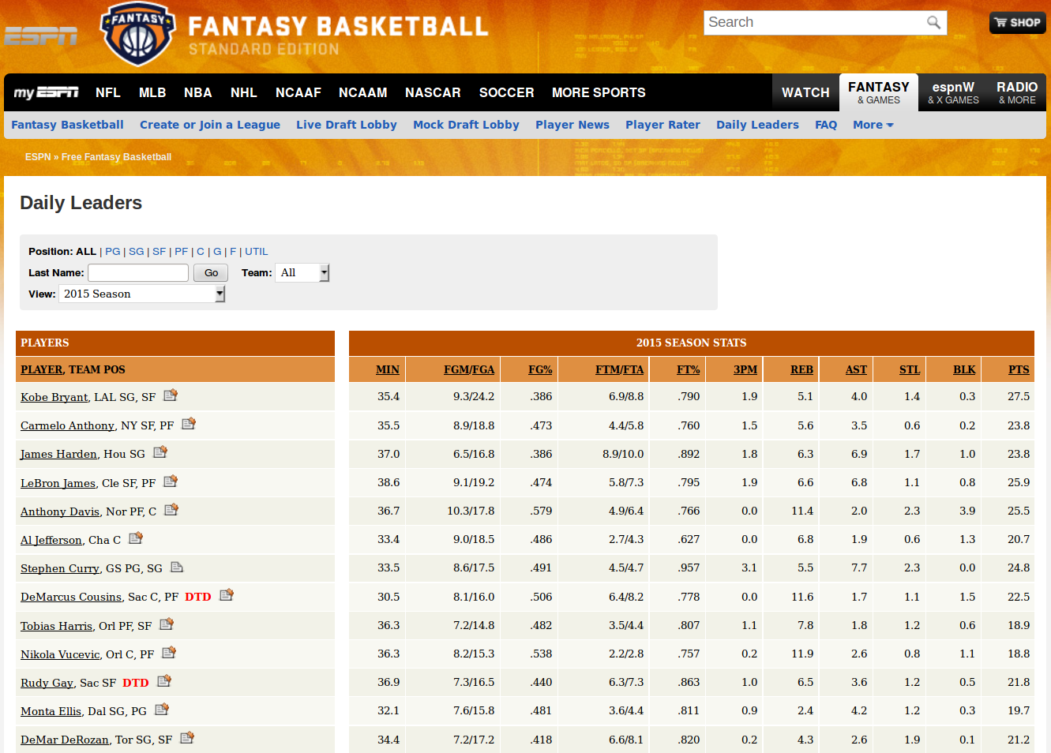
Motivation
Fantasy Games
Skills
Goal: Find a group of players for Fantasy Basketball
3

Slide 5
Problem Definition
What is Skyline Group?
NBA Players Score
 | SUM |  |  | MIN |  |  | MAX
 | P | R | B | P | R | B | P | R | B
P1, P2, P3 | 11 | 11 | 11 | 3 | 2 | 3 | 4 | 5 | 5
P1, P2, P4 | 9 | 7 | 10 | 2 | 1 | 2 | 4 | 4 | 5
P1, P2, P5 | 11 | 7 | 10 | 3 | 1 | 2 | 4 | 4 | 5
P1, P3, P4 | 9 | 10 | 10 | 2 | 1 | 2 | 4 | 5 | 5
P1, P3, P5 | 11 | 10 | 10 | 3 | 1 | 2 | 4 | 5 | 5
P1, P4, P5 | 9 | 6 | 9 | 2 | 1 | 2 | 4 | 4 | 5
P2, P3, P4 | 10 | 8 | 8 | 2 | 1 | 2 | 4 | 5 | 3
P2, P3, P5 | 12 | 8 | 8 | 4 | 1 | 2 | 4 | 5 | 3
P2, P4, P5 | 10 | 4 | 7 | 2 | 1 | 2 | 4 | 2 | 3
P3, P4, P5 | 10 | 7 | 7 | 2 | 1 | 2 | 4 | 5 | 3
 | Points | Rebounds | Blocks
P1 | 3 | 4 | 5
P2 | 4 | 2 | 3
P3 | 4 | 5 | 3
P4 | 2 | 1 | 2
P5 | 4 | 1 | 2
Skyline Players
Skyline Groups
Find a group of 3 players
5 Choose 3 = 10 possible groups
4

Slide 6
Problem Definition
Why Skyline Group?
NBA Players Score
 | SUM |  |  | MIN |  |  | MAX
 | P | R | B | P | R | B | P | R | B
P1, P2, P3 | 11 | 11 | 11 | 3 | 2 | 3 | 4 | 5 | 5
P1, P2, P4 | 9 | 7 | 10 | 2 | 1 | 2 | 4 | 4 | 5
P1, P2, P5 | 11 | 7 | 10 | 3 | 1 | 2 | 4 | 4 | 5
P1, P3, P4 | 9 | 10 | 10 | 2 | 1 | 2 | 4 | 5 | 5
P1, P3, P5 | 11 | 10 | 10 | 3 | 1 | 2 | 4 | 5 | 5
P1, P4, P5 | 9 | 6 | 9 | 2 | 1 | 2 | 4 | 4 | 5
P2, P3, P4 | 10 | 8 | 8 | 2 | 1 | 2 | 4 | 5 | 3
P2, P3, P5 | 12 | 8 | 8 | 4 | 1 | 2 | 4 | 5 | 3
P2, P4, P5 | 10 | 4 | 7 | 2 | 1 | 2 | 4 | 2 | 3
P3, P4, P5 | 10 | 7 | 7 | 2 | 1 | 2 | 4 | 5 | 3
 | Points | Rebounds | Blocks
P1 | 3 | 4 | 5
P2 | 4 | 2 | 3
P3 | 4 | 5 | 3
P4 | 2 | 1 | 2
P5 | 4 | 1 | 2
What’s wrong with taking most expert in each field?
Any other group is dominated by a Skyline
5
Notes:
323 212 312 212 412

Slide 7

Solution Framework
Baseline Method
Input
n players/tuples
group size k
aggregate function
(sum/min/max)
group generation
(SUM / MIN / MAX)
skyline operation
n, k
all skyline groups
Problems
Exponential group generation. We may not afford to compute or store them.
Example: For n = 2000, k = 3.
1331334000 groups
30 GB space [assuming 24B for each group]
15 days time [assuming 1 millisecond for each group]
6

Slide 8
Solution Framework
Advanced Method: WCM
Weak Candidate Generation Property: If G is a k tuple skyline group, then there is at least one (k-1) tuple subset of G such that it is a (k-1) tuple skyline group.
Example:
P1, P2, P3
3 tuple skyline group
P2, P3
P1, P2
P1, P3
At least one of them is a 2 tuple skyline group
Does this property sound familiar?
Aprioi Principle: If an itemset is frequent, then all of its subsets must also be frequent
7

Slide 9
Comparison Between
Apriori & WCM Property
null
A
B
C
D
Non-Frequent Itemset
BC
AD
AB
AC
BD
CD
ABC
ABD
BCD
ACD
null
ABCD
A
B
C
D
Non 2 tuple
Skyline Group
Apriori Principle
AB
AC
BC
AD
BD
CD
ABC
ABD
BCD
ACD
WCM has less pruning power than Apriori
ABCD
WCM Property
8

Slide 10
WCM Algorithm
Input: n tuples, group size k, aggregate function = min/max (not sum)
Let, i = 1
Generate 1 tuple Candidate groups, C1 = all n tuples
Generate 1 tuple Skyline groups, S1 = skyline_operation(C1)
for i = 2 to k
Generate i tuple Candidate groups, Ci from Si-1
Generate i tuple Skyline groups, Si = skyline_operation(Ci)
Return Sk
9

Slide 11
WCM Algorithm
Explained with Example
Input: n tuple {P1, P2, P3, P4, P5}, group size k = 3, aggregate function = min
 | P | R | B
P1 | 3 | 4 | 5
P2 | 4 | 2 | 3
P3 | 4 | 5 | 3
P4 | 2 | 1 | 2
P5 | 4 | 1 | 2
 | P | R | B
P1 | 3 | 4 | 5
P3 | 4 | 5 | 3
 | P | R | B
P1,P2 | 3 | 2 | 3
P1,P3 | 3 | 4 | 3
P1,P4 | 2 | 1 | 2
P1,P5 | 3 | 1 | 2
P3,P2 | 4 | 2 | 3
P3,P4 | 2 | 1 | 2
P3,P5 | 4 | 1 | 2
 | P | R | B
P1,P3 | 3 | 4 | 3
P3,P2 | 4 | 2 | 3
S1
S2
Note that, (P2,P4), (P2,P5) and (P4,P5) are not generated in C2.
 | P | R | B
P1,P3,P2 | 3 | 2 | 3
P1,P3,P4 | 2 | 1 | 2
P1,P3,P5 | 3 | 1 | 2
P3,P2,P4 | 2 | 1 | 2
P3,P2,P5 | 4 | 1 | 2
C1
 | P | R | B
P1,P3,P2 | 3 | 2 | 3
P3,P2,P5 | 4 | 1 | 2
C2
S3
C3
10
Notes:
323 212 312 212 412

Slide 12
Question
?
11

Slide 13
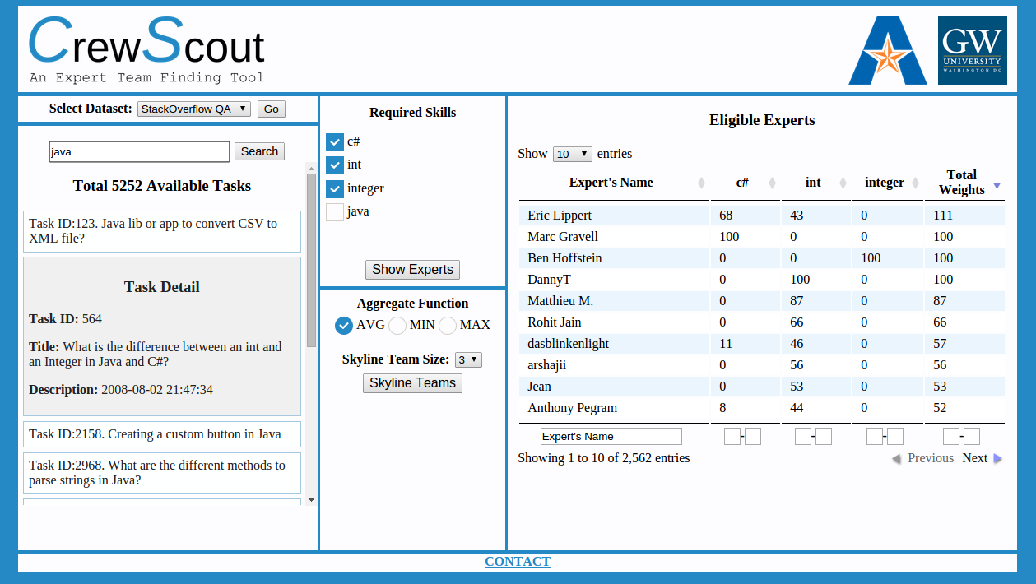
CrewScout System
http://idir.uta.edu/crewscout
12

Slide 14
Thank You!

